Slide 1
The Relationship Between Car Use, Age, and Accidents
An R-Based Analysis of Car Insurance Data
PRESENTED BY Thapelo mAtlejoane
date > 18 sepTEMBER 2025

Slide 2
Data Import & Cleaning
Objective: To prepare the raw dataset for analysis by addressing common data issues.
Key steps:
- Import: The Cars.csv dataset was loaded into R
Missing Data: Confirmed and removed rows with missing values using na.omit().
Duplicates: Identified and removed duplicate rows to ensure each customer entry is unique using distinct()
Outcome: A clean_Cars_data dataset ready for analysis.

Slide 3
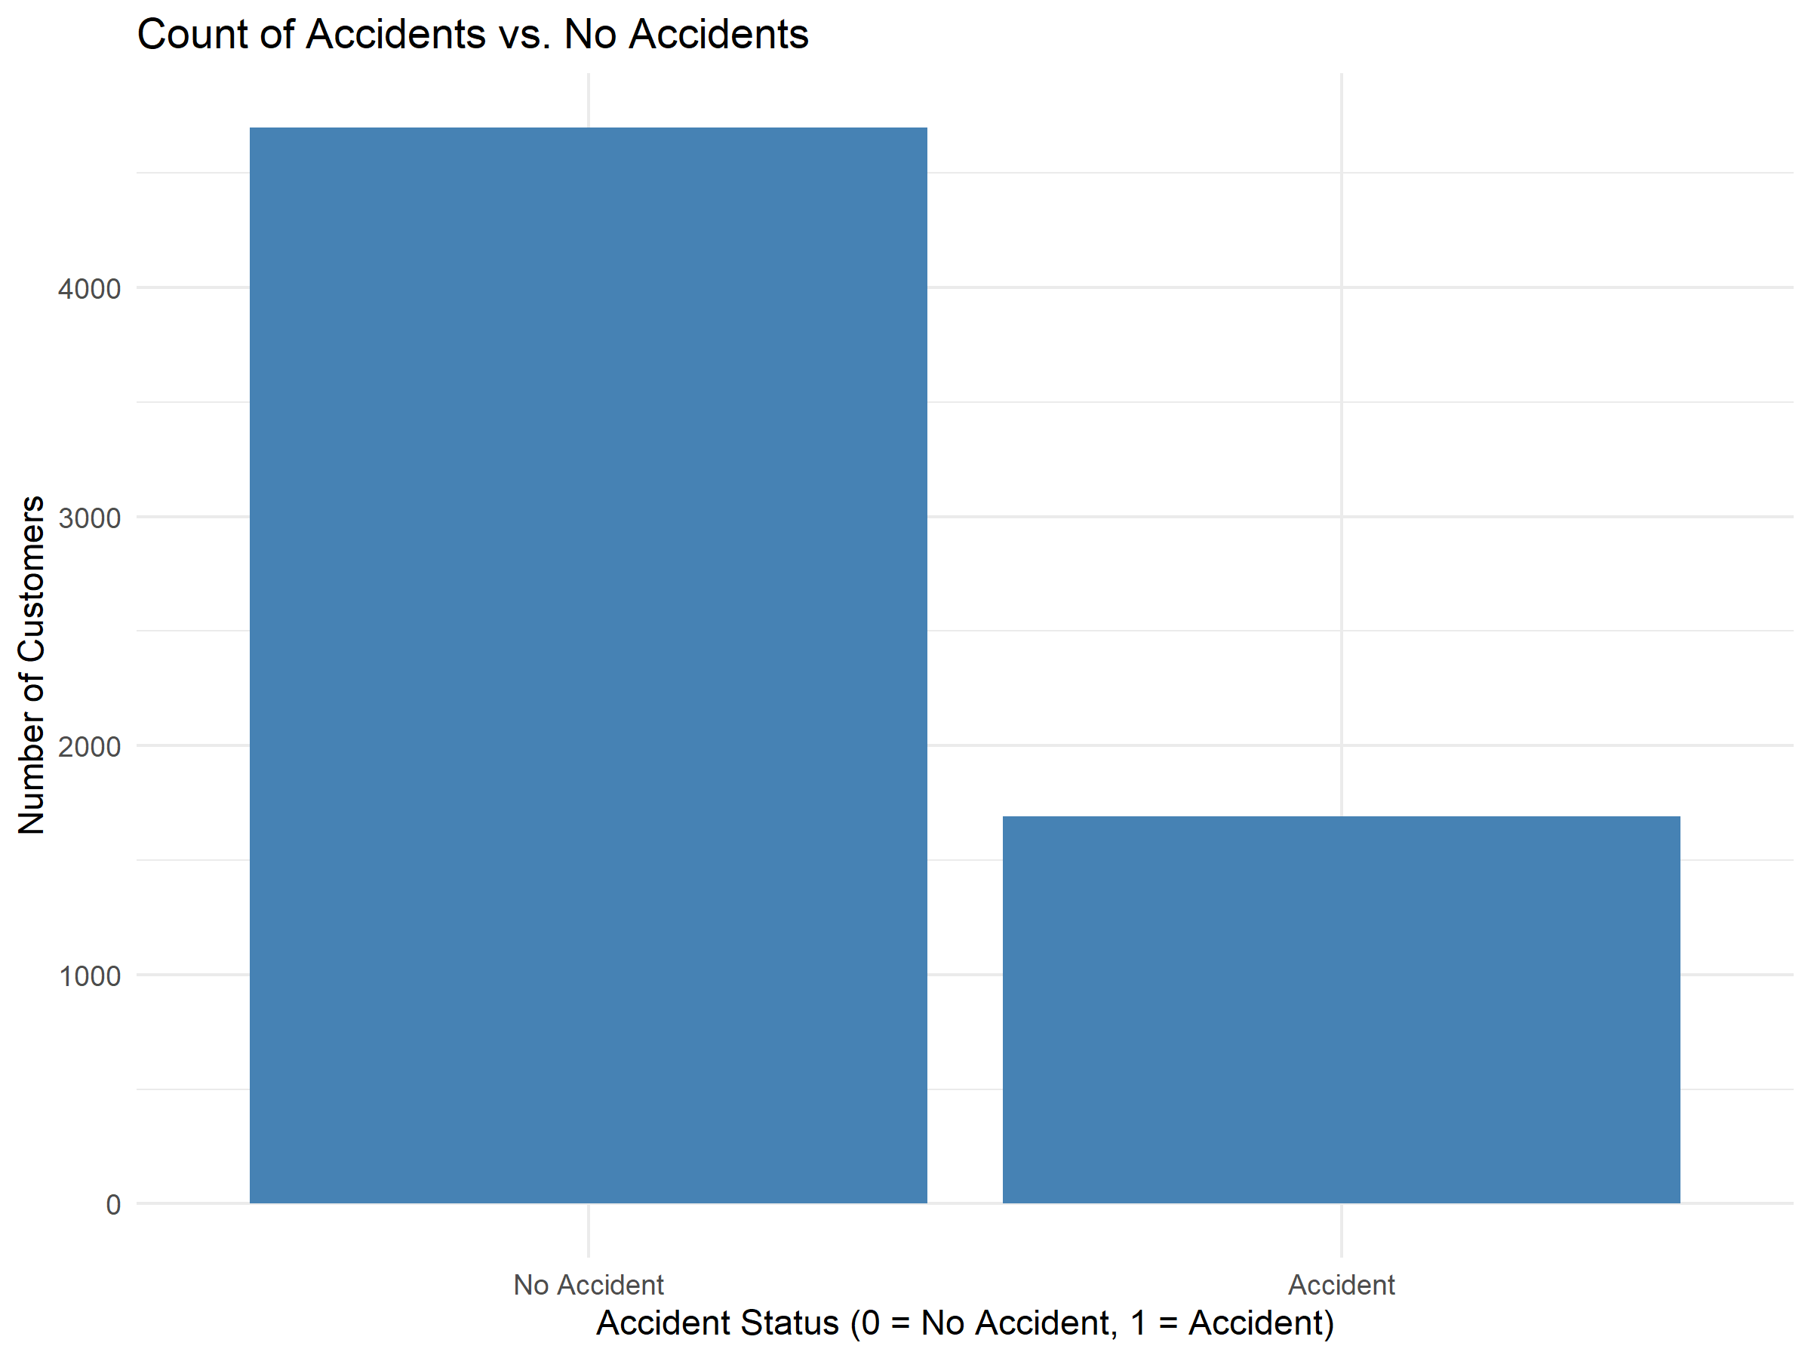
Customer Accidents: Proportions and Visuals
Objectives: To understand the proportion of customers who have ben in an accident.
Key Findings:
-The proportion of customers who have had a recent accident (TARGET_FLAG = 1) is approximately 26%
Visual:
- Bar Plot of Accidents Status: A bar plot shows the count of customers who have had an accidents versus those who have not. The bar for “No Accidents” is significantly taller than the bar for “Accident”

Slide 4
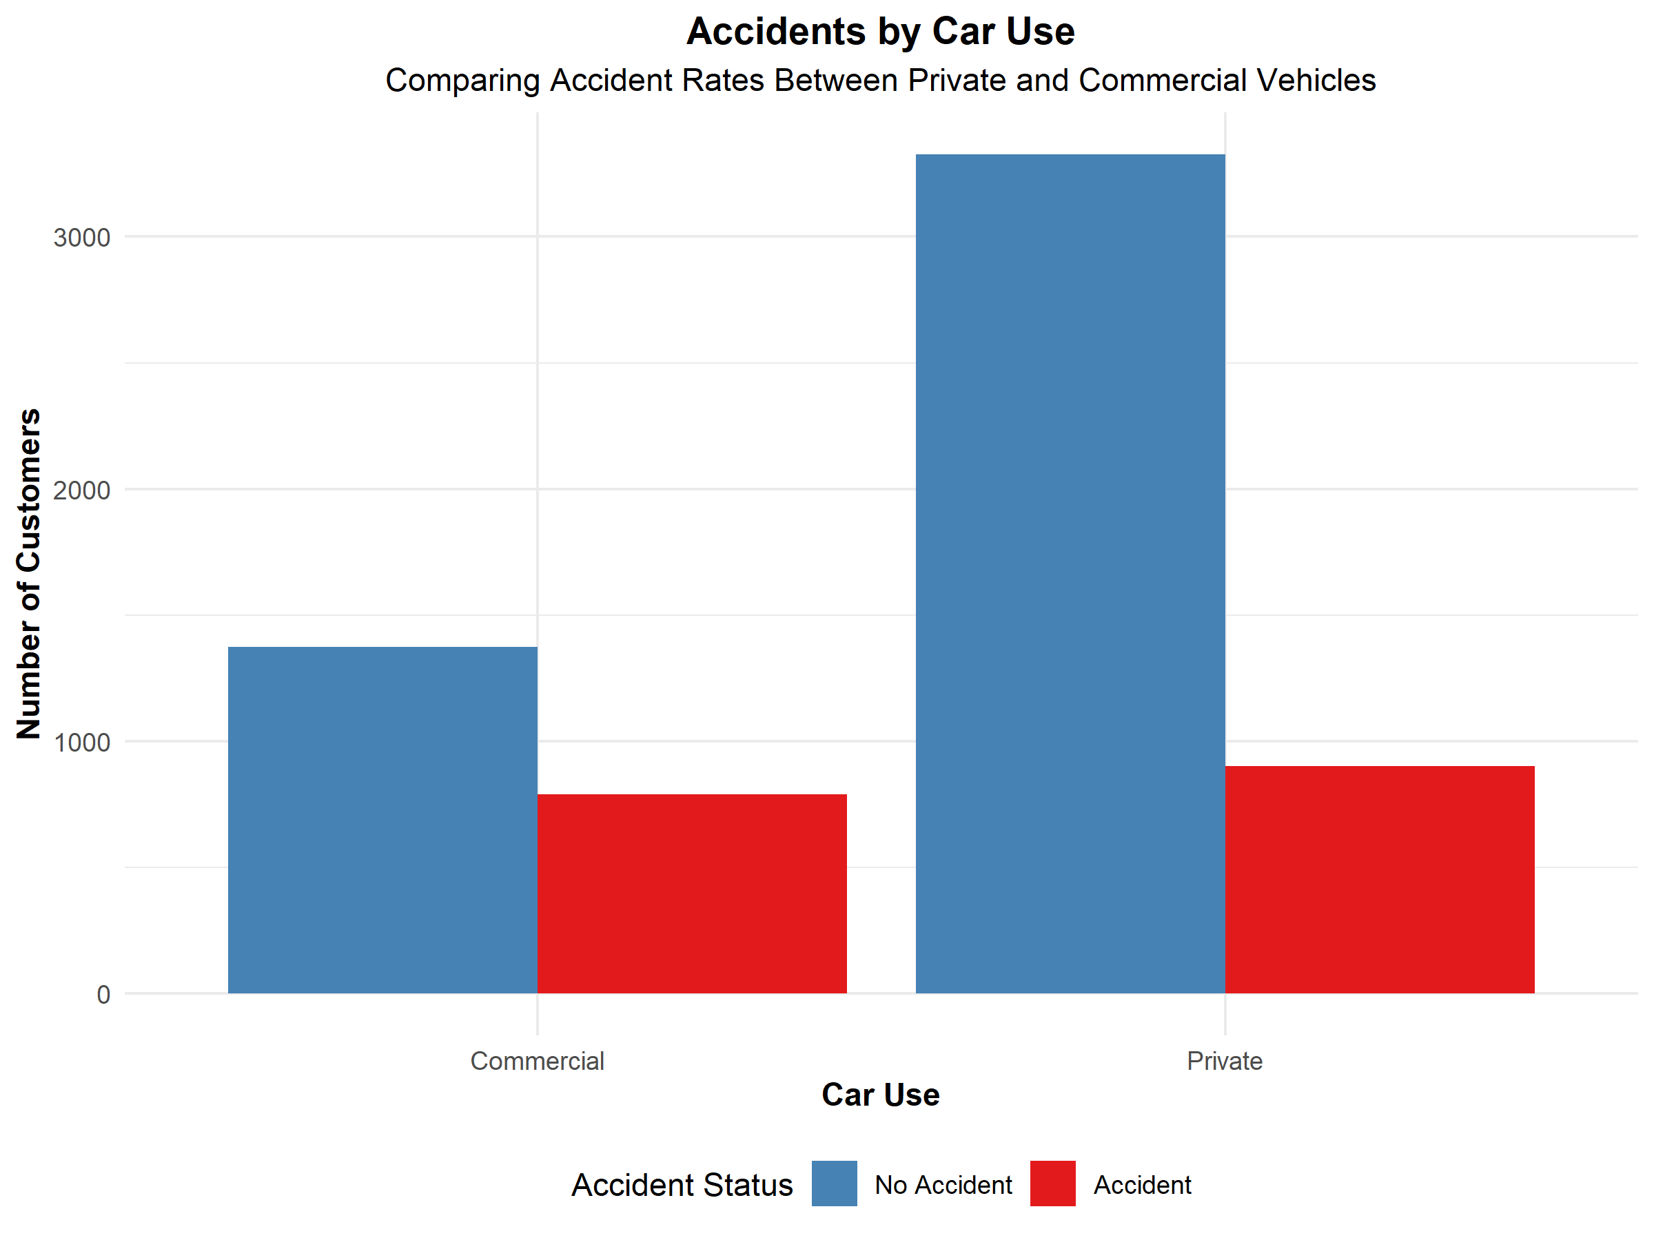
Car Use and Accidents
Objectives: To investigate the relationship between a car’s use type (Private vs Commercial) and the likelihood of an accident.
Key Steps:
Data conversion: converted CAR_USE AND TARGET_FLAG to numeric formats for modelling.
Correlation: Calculated the correlation coefficient between car use type and accidents status
Key Findings:
A positive correlation exists , suggesting a link between commercial use and a higher likelihood of an accident.
Logistic Regression: A statistical model was created to predict the likelihood of an accident based on car use.
Visual:
-Bar Plot of Accidents by Car Use: This plot visually compares the number of accidents for private versus commercial vehicles. It shows a clear difference, with more commercial vehicles having accidents on car use.

Slide 5
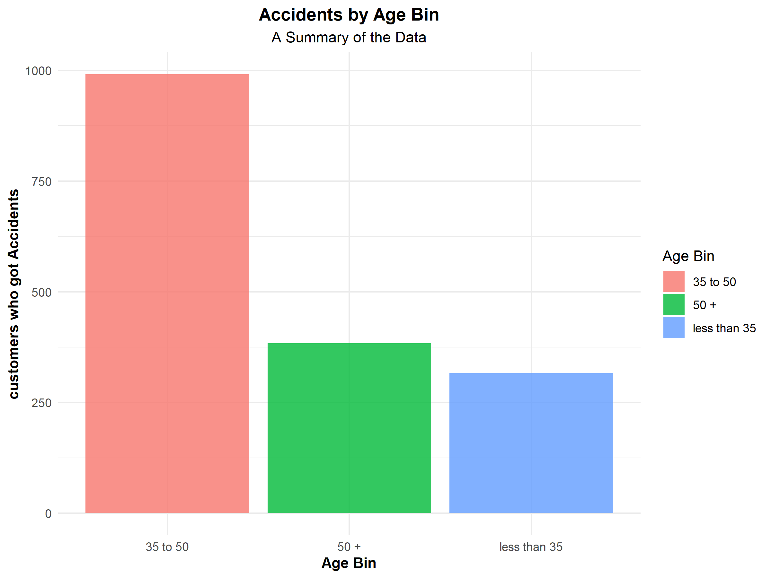
Accidents by Age Group
Objective: To see if age plays a role in the number of accidents.
Key Steps:
Age Bins: The age variables was divided into three bins: less than 35,35 to 50, and 50+.
Key Findings:
The bar graph reveals the number of accidents for each age group. It may show that a particular age group ,perhaps the youngest or oldest, has a disproportionate number of accidents.
Visual:
-Bar Plot of Accidents by Age Bin: This graph shows te total number of accidents for each age group

Slide 6
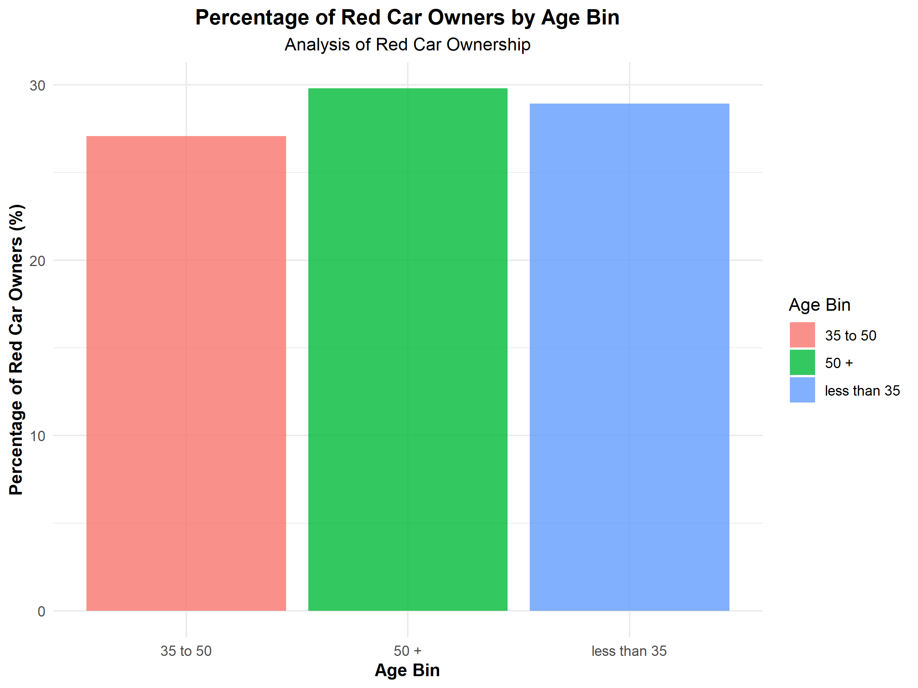
Red Car Ownership by Age
Objective: To analyze a fun fact: the percentage of peole who own a red car within each age group.
Key Step:
-Data Aggregation: Calculated the percentage of red car owners for each age bin.
Key Findings:
The analysis reveals if red car ownership is more common in a specific age group.
Visual:
-Bar Plot of Red Ownership Percentage: This bar plot shows the percentage of red car owners for each age bin, making it easy to compare across groups.

Slide 7
Summary of Findings
Overall Conclusions:
- Accident Proportions: About a quarter of customers have an accident.
- Car Use Impact: Commercial vehicles have a higher risk of accidents than private vehicles.
Recommendations:
- Use these insights to inform risk assessment and insurance premium calculations. For example , commercial vehicles and certain age groups may require higher premiums.

